Slide 1
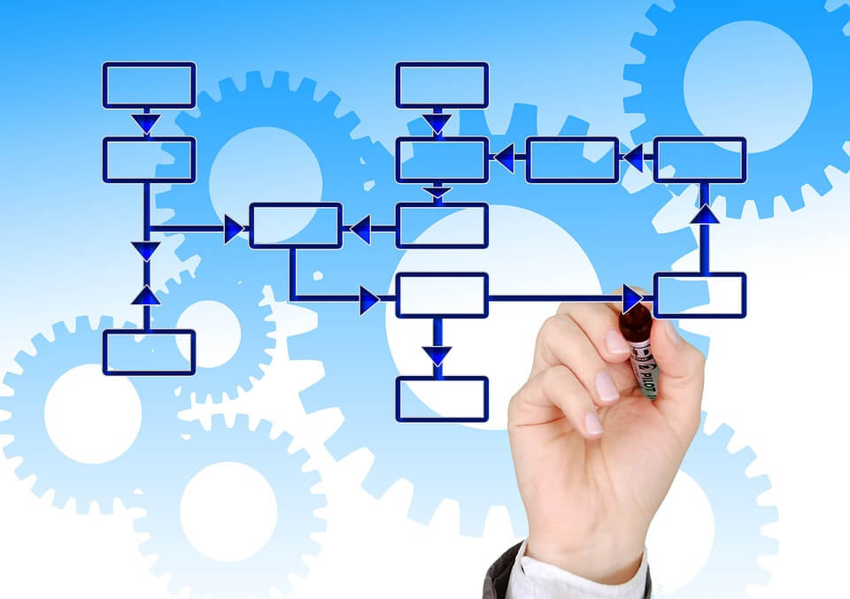
A Cloud- and Container-Based Approach to Microservices-Powered Workflows
Lucas Jellema, CTO of AMIS
CodeOne 2018, San Francisco, USA
Notes:
A Cloud- and Container-Based Approach to Microservices-Powered Workflows
Microservices are independent—sure. Complex transactions and workflows may still require contributions from several microservices. This session describes how microservices can seemingly collaborate without sacrificing their independence. Workflow choreography, rather than orchestration, and events for data exchange, rather than synchronous interactions, are key to implementing workflows in a robust, flexible, and scalable way that can deal with horizontal and stateless and even serverless scalability and continuous, flexible upgrades. Generic capabilities are introduced for monitoring, workflow instance recovery, scheduling, human notifications, and routing slip management. Live demonstrations illustrate and prove the proposed approach.
https://dzone.com/articles/patterns-for-microservices-sync-vs-async
https://blog.bernd-ruecker.com/hack-day-experiments-with-the-cloud-and-orchestration-of-serverless-functions-2f8aeb51e343
https://zeebe.io/what-is-zeebe/
https://zeebe.io/blog/2018/09/microservices-orchestration-survey-results-recap/
https://github.com/berndruecker/flowing-retail
https://www.infoq.com/presentations/event-flow-distributed-systems

Slide 2




Lucas Jellema Architect / Developer 1994 started in IT at Oracle 2002 joined AMIS Currently CTO & Solution Architect

Slide 3
Overview
Definitions – what is workflow | microservice
And what are objectives & requirements
Bare essence of workflow
Challenges with workflows – especially in a microservices world
Approaches
Orchestrated
Choreographed
Hybrid
Required components
Tools & technologies

Slide 4
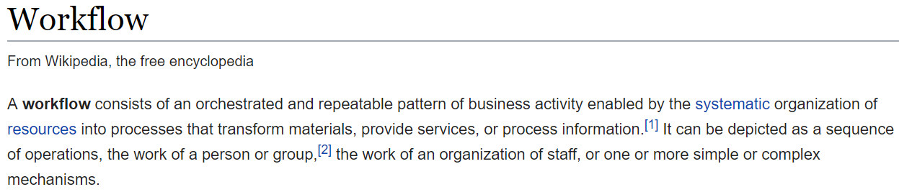
Defining Workflow
Cross domain cutting concern
Composite transaction
Multi-step chain
Long running process
System initiated human participation

Slide 5

Objectives
Flows completed
In time
Following the plan
Handling of non-happy situations
Efficient execution
Regarding resource usage (compute and human)
Agility – easily adaptable

Slide 6
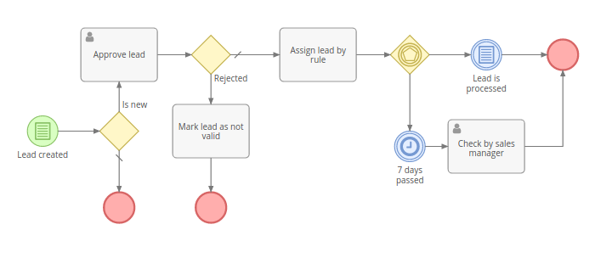
Examples
From Webshop Order to Fulfillment and Invoice
CI/CD Pipeline – from source code to running container
Composite Order (“concert ticket, flight ticket, hotel reservation, car rental”)
Travel Approval process
CQRS-style refresh of query-stores upon update of command-database
Bid management process
From Blood Sample to Lab Results and Notification
Nightly job to process data [in several steps]
Process complex incoming message into multiple domains [and data stores]
From “order food to deliver meal”
ChatBot – conversation flow
Synchronous Service Call Retry
…
Notes:
https://docs.microsoft.com/en-us/azure/architecture/microservices/ingestion-workflow

Slide 7
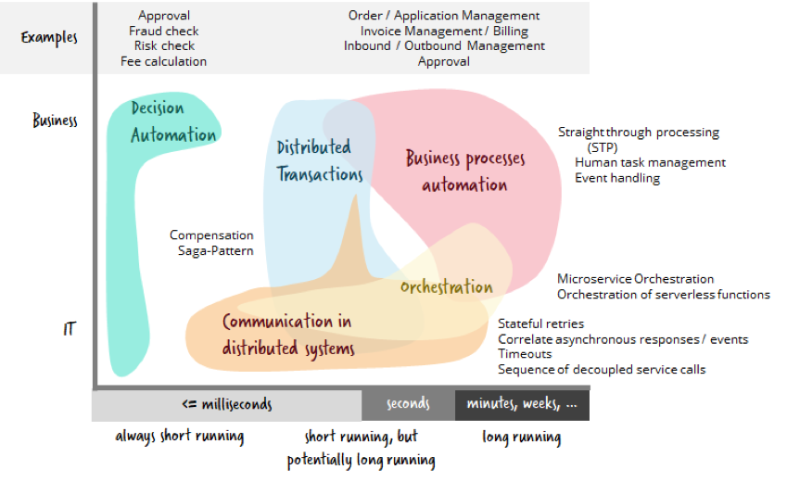
Source: https://thenewstack.io/5-workflow-automation-use-cases-you-might-not-have-considered/
Notes:
https://thenewstack.io/5-workflow-automation-use-cases-you-might-not-have-considered/

Slide 8
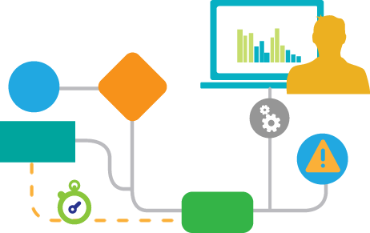
Constituents of a Workflow
Activities (& roles)
Flow logic
Sequence
Conditional
Events (including time)
Loop
Parallellism
Deadlines
Events and Signals that trigger or influence
Transaction boundaries
Succeed or rollback together
Exceptions, non-happy-flow, compensation handlers
State – data associated with an instance of a workflow
Including the progress & status of the instance (where are we at?)
Business indicators (per instance and across instances) & business monitoring

Slide 9
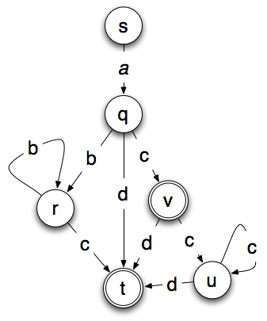
Workflow Design | Blueprint
Communication with business
Input for implementation of workflow
Input for implementing business monitoring & reporting
Input for a workflow engine – to execute
Examples of formal notation methods:
BPMN
BPEL
CMMN
Harel Statecharts
State Diagrams
Petri net
Notes:
https://www.wikiwand.com/en/Petri_net
Around slide 9 or 10 you might want to highlight that some workflows are just documentation (traditional process modelling sort of say) and others are execution which is what you’re focusing on

Slide 10
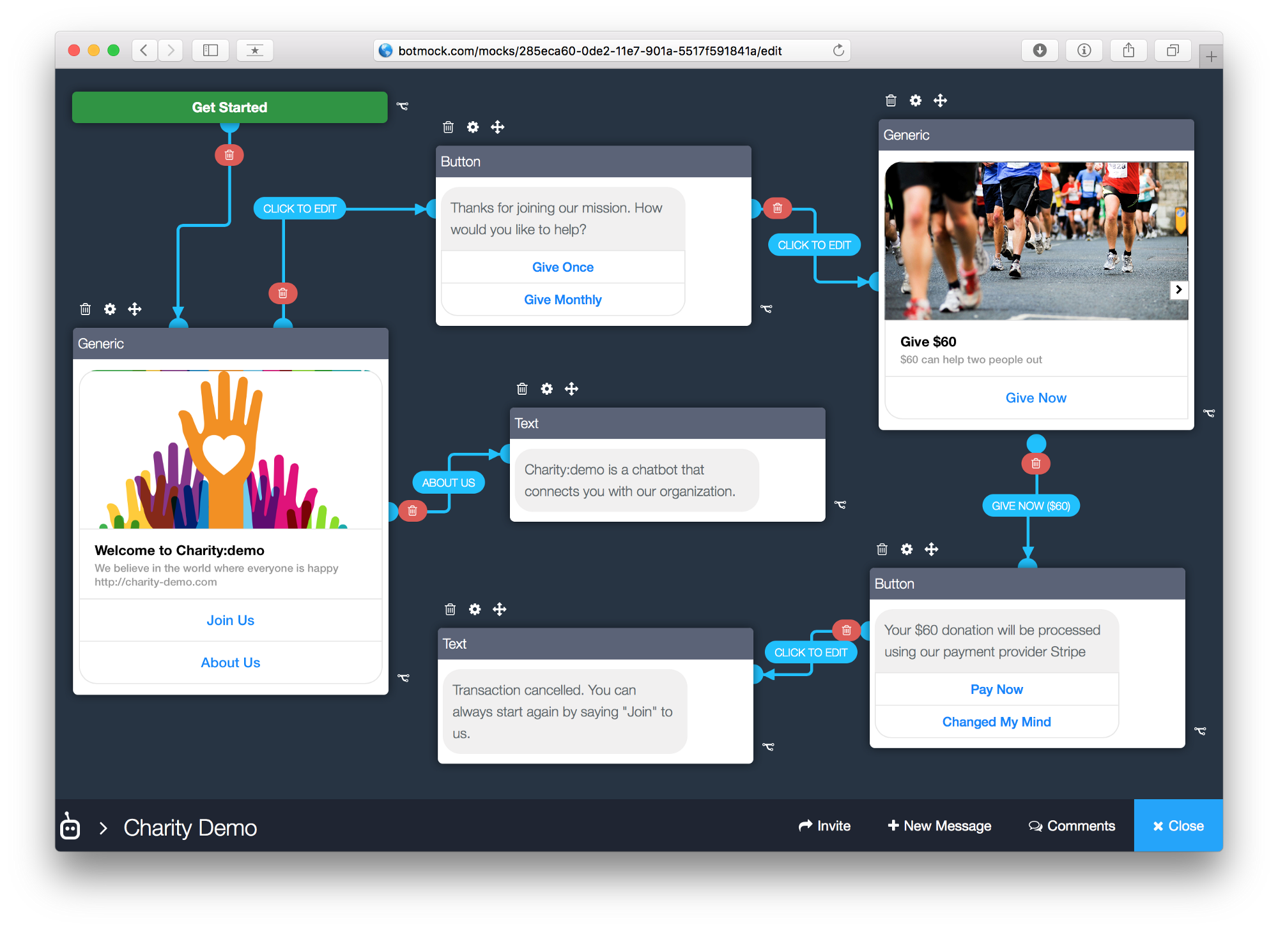
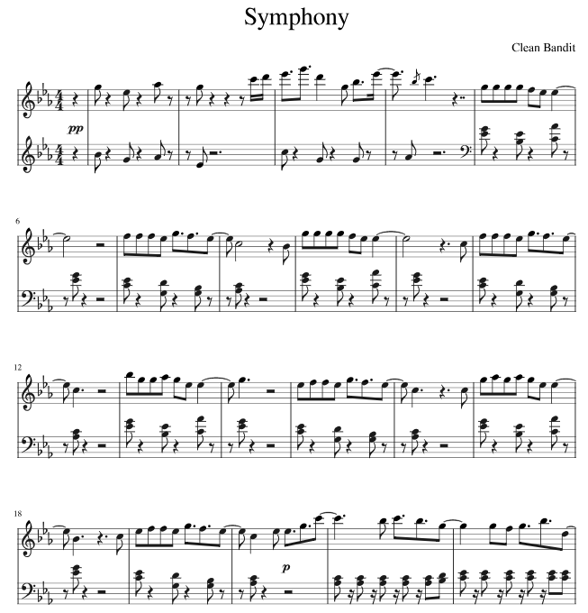
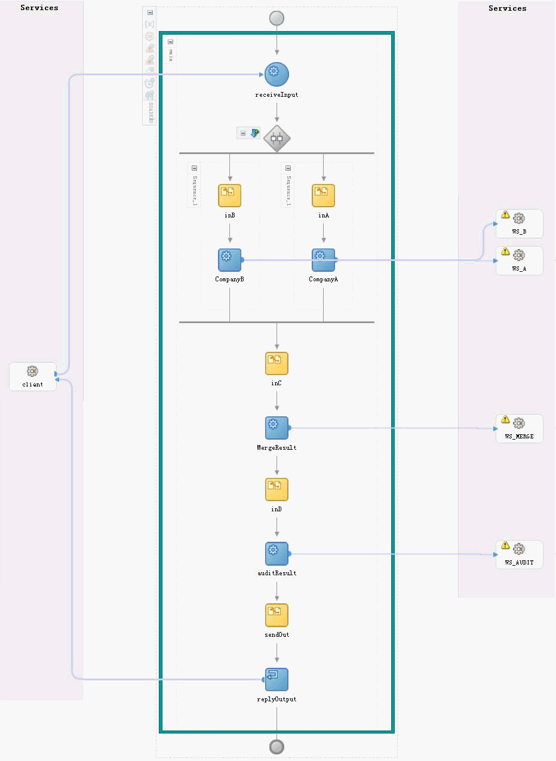
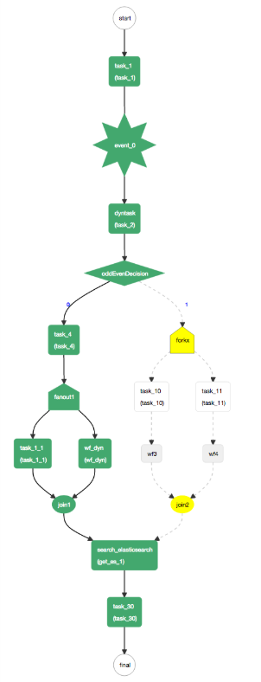
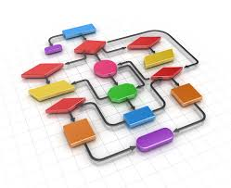
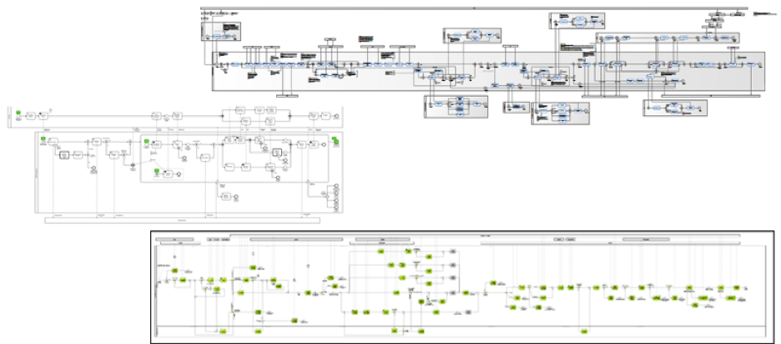
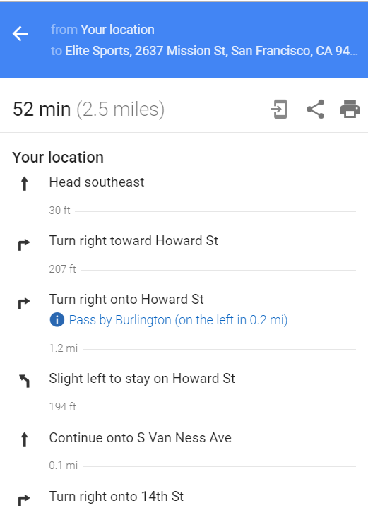
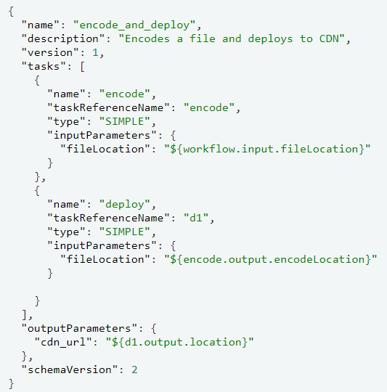
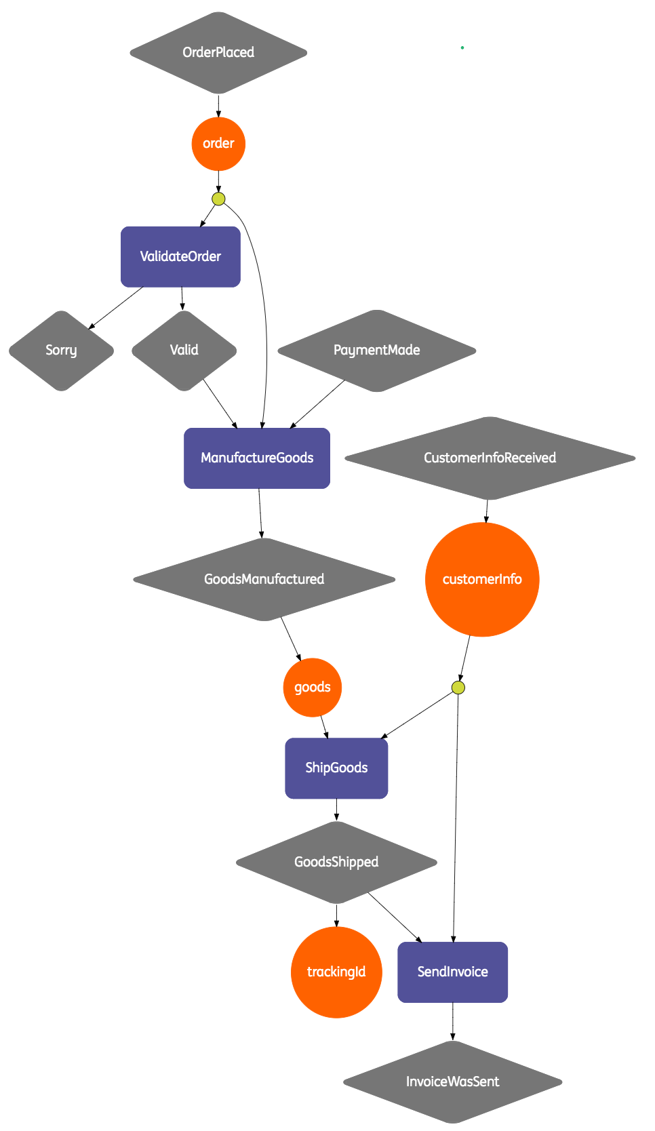
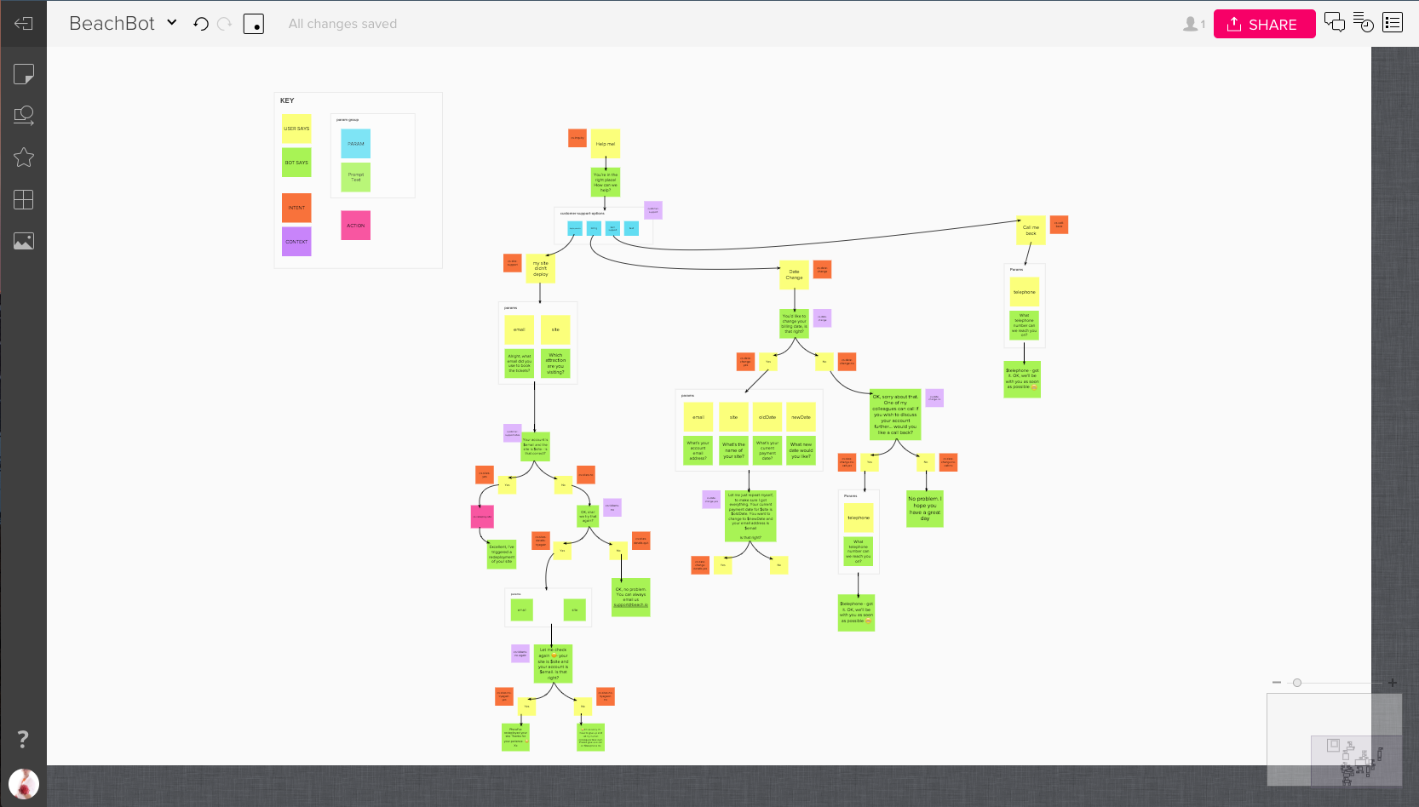
Examples of workflow designs
Notes:
https://netflix.github.io/conductor/metadata/kitchensink/
https://github.com/ing-bank/baker
https://thenewstack.io/5-workflow-automation-use-cases-you-might-not-have-considered/

Slide 11
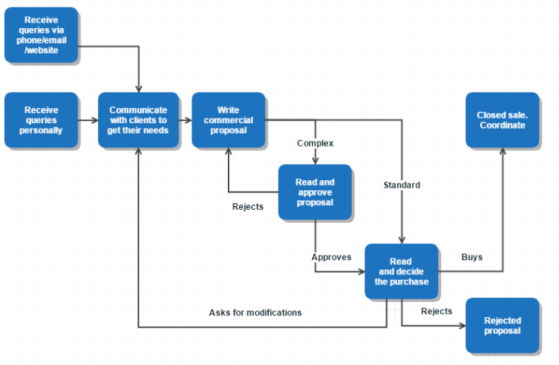
At the core
The logical definition of the workflow combined with the current state of the instance and the current time (or other external conditions)
Define a state transition to one or more “To Do items” for activity types in the context of the workflow instance
Including non-happy exception items (for example when previous to-do item timed out)
The To Do items should be made available to actors (for example microservices)
Including (reference to the) state
Actors can ‘take on’ a To Do item – typically exclusively
They can read and extend the state of the workflow instance
(Including completing | failing | returning the task)

Slide 12
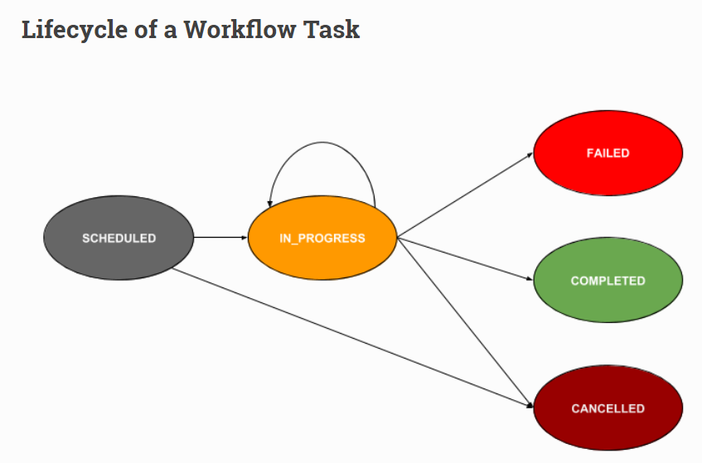
Tasks go through states
Task == Workflow Step == Activity
Each state change requires reevaluating the workflow-instance
Notes:
Picture from Conductor
https://netflix.github.io/conductor/metadata/

Slide 13
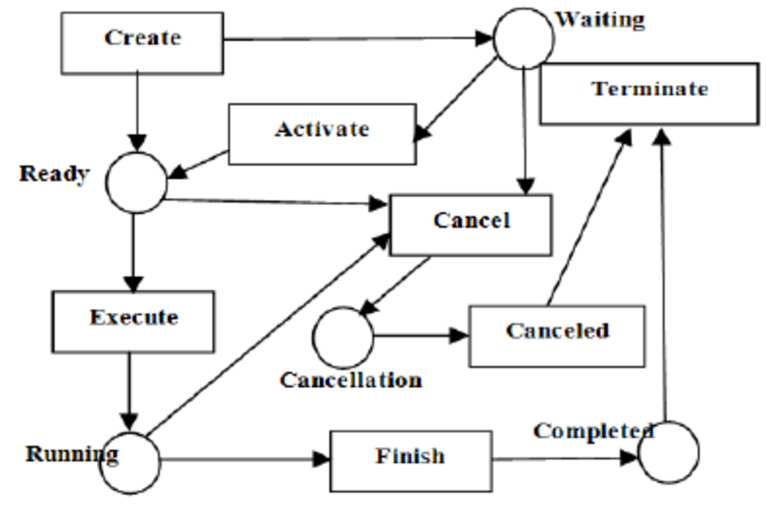
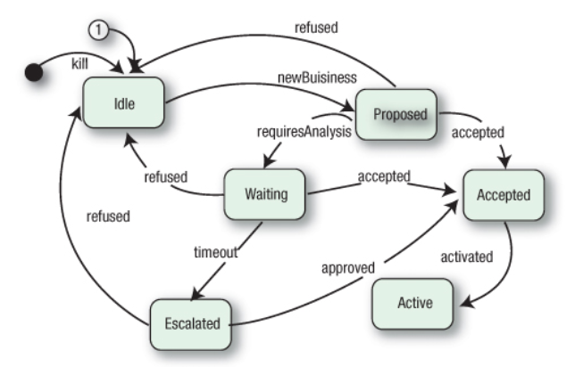
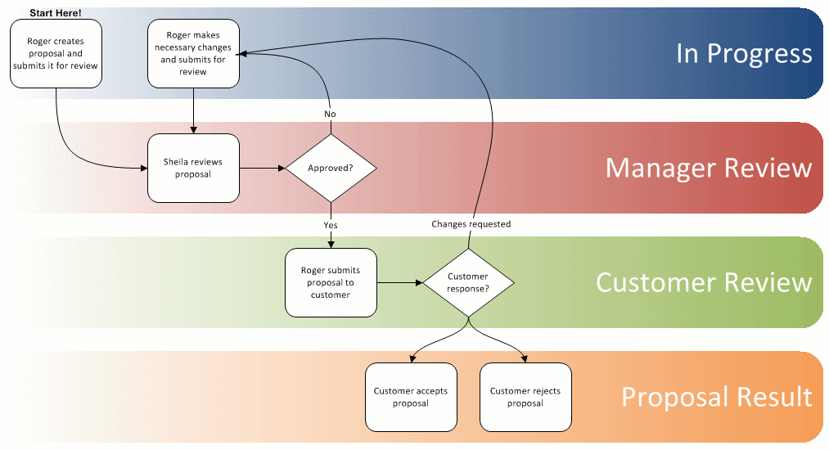
Workflow instances go through states Both from a Business and an Operational perspective
New
Running
Waiting on
Actors
Events
Failed
Completed

Slide 14


Microservices
Business Agility
Functionality: quick, cheap, effortless and risk free
IT Agility
Non-functionality: scale, resilience, infrastructure & location
Independent components
Asynchronous communication – whenever possible
Encapsulated
Location does not matter
Strictly within one domain, owned by one team
Not too big or complex
Horizontally Scalable (multiple instances )
Ephemeral, Stateless
Enabling Automated DevOps

Slide 15
To make workflows work in a microservices arena…
Ensure workflow instances are completed according to plan
Agile evolution of workflow definitions (and data structure)
Short & Long-running workflow
Provide business insight in status and progress
Manage data context for Workflow instance
Persist
Share
Update
Derive next state
from data context
Event (time)
Workflow definition
Workflow in Microservices Land
Prevent multiple actors from working on the same task
Detect tasks not picked up or abandoned
Act on events & functional timeouts
Microservice (& Lambda [Stateless] Functions)
Assume that ownership for each workflow lies in one domain
Someone cares – because of what that team tries to achieve
Preferably Asynchronous communication
Multiple instances of actors (stunt doubles and more)
Distributed/unknown | changing location
Poly-tech implementations
Frequent scale & redeploy & replace (plus A/B and Canary)
Smart Endpoints, Dumb Pipes
Cloud – wide area network
Containers – ephemeral (stateless), restart, multi-instance

Slide 16
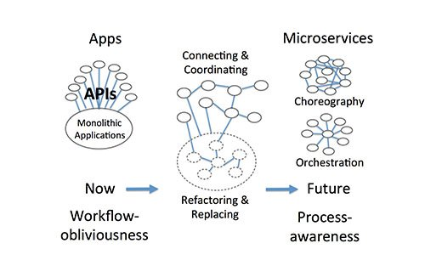
Approaches
Orchestration
Choreography
Hybrid
Coordinated | Facilitated Choreography
Mixing orchestration and choreography

Slide 17
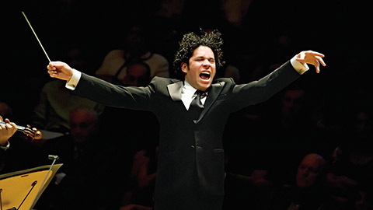
Orchestration
Central coordination
Flow logic
Actor invocation (synchronous?) and communication
Transaction
Exception, Timeout and Event & Signal handling
Workflow instance state & data content
Within and/or across domains
actor
Workflow Orchestration Engine
actor
actor

Slide 18

Orchestration – challenges & undesirabilities
Hard dependency on actors: what, where, how to invoke
Any change in actor may impact central orchestrator
Monolithic orchestrator may become bottleneck
Physically (defying Ops – scale, patch, …)
Mentally (god service, omniscient )
(in the past?) very not agile:
running instances, changing data structure & workflow definitions
Several products provide(d) this capability – and have sometimes made life hard and given workflow orchestration a bad name
Oracle BPM Suite, Camunda, jBPM, Activiti, Pega Systems, Tallyfy, Bizagi, Oracle Integration Cloud (PCS), IBM Business Process Manager, Red Hat Process Automation Manager

Slide 19
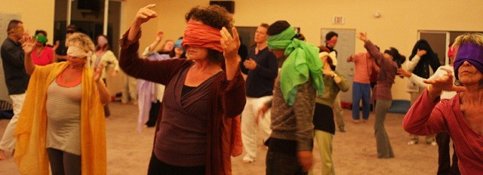
Choreography
No one is owner of the workflow instance
Full independence between all actors
Microservices know nothing about each other
Events trigger them into action
Their end state is published through an event
The workflow does not explicitly exist
Arises as sequence of independent microservice actions
Microservice need to know about the event that should trigger them
Highly flexible
As long as actors are acting on events – they can be anywhere, scaled in anyway, doing anything and be implemented in any technology

Slide 20
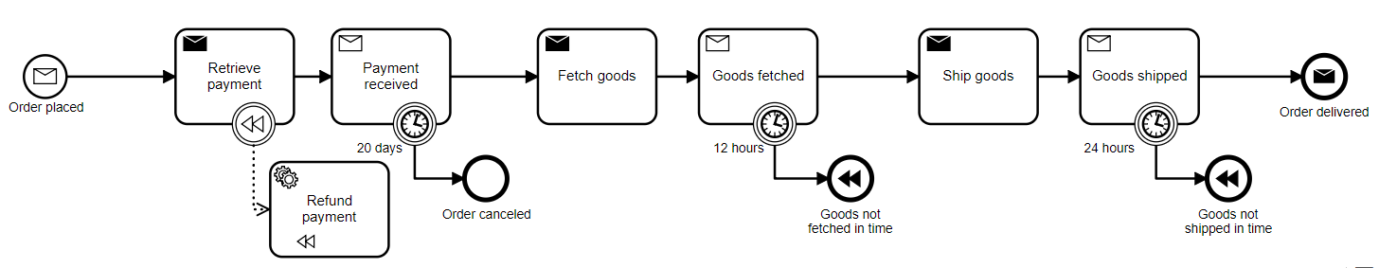
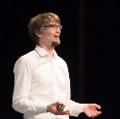
Example of Choreography – Flowing Retail – Process Order
Shop & Checkout
Payment
Inventory
Shipment
Source: Bernd Rücker, https://github.com/berndruecker/flowing-retail

Slide 21
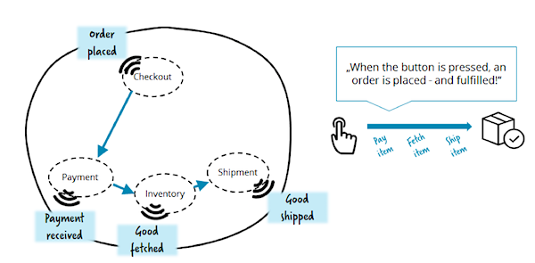
Example of Event Driven Choreography – Flowing Retail
Order Completed

Slide 22
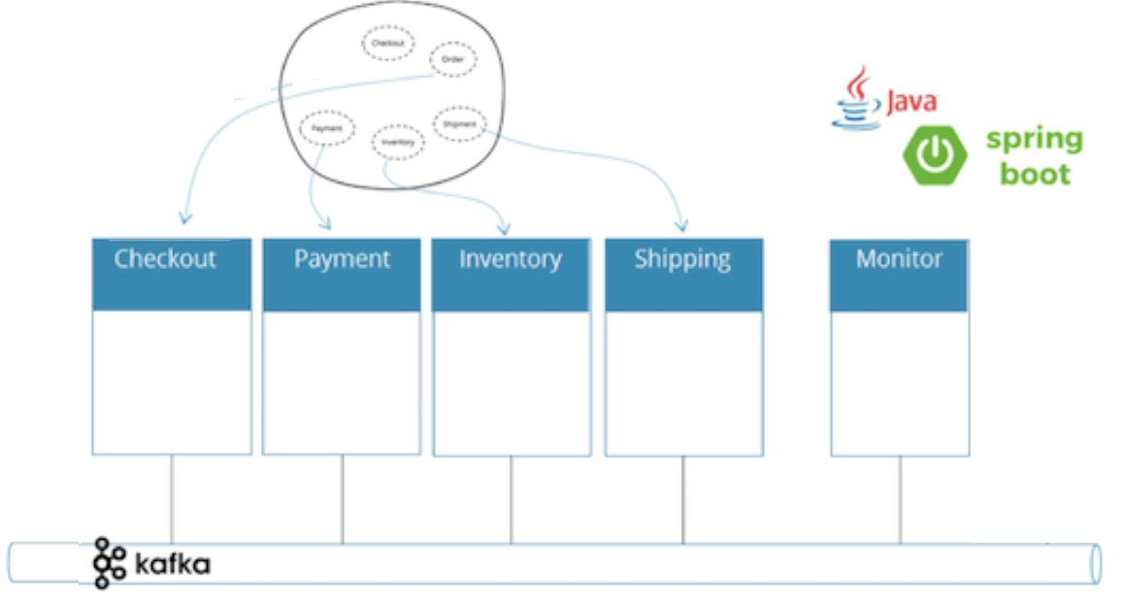

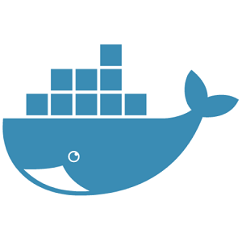
Pure Choreography - demo

Slide 23
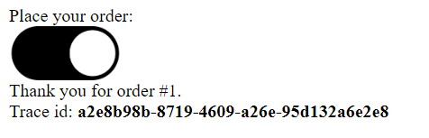
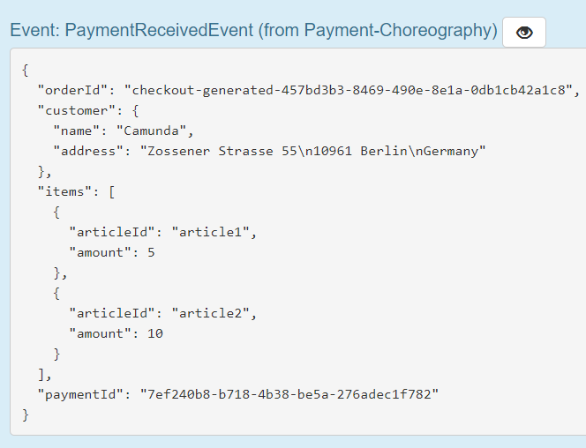
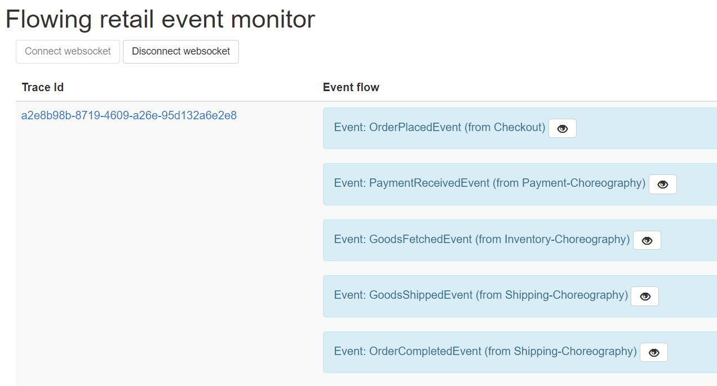

Slide 24
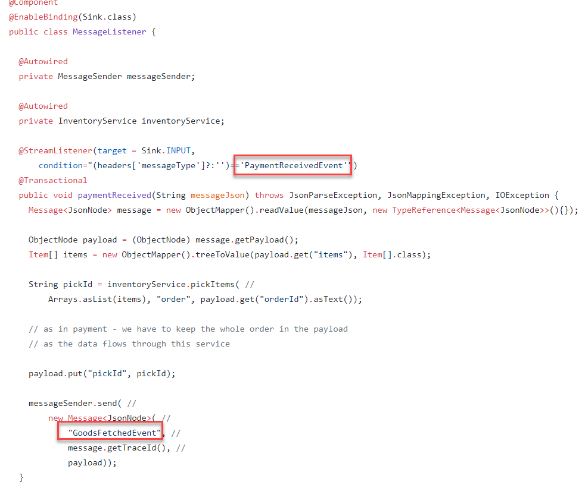
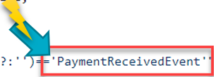
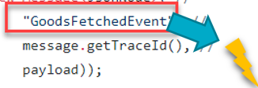
Code in Actor Inventory

Slide 25
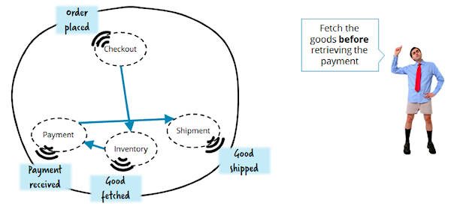
Choreography Challenges
How to share the workflow state (“data context”)
Hard to implement flow logic – e.g. conditional actions or loops
Hard to handle parallel activities on same “instance”
State is payload of event
Changing the implicit workflow requires changing the microservices
The way they respond to events
Tracing the workflow is hard
Detecting and fixing stuck and failing workflow instances is hard
Who determines if the Order is completed?
Order Completed

Slide 26
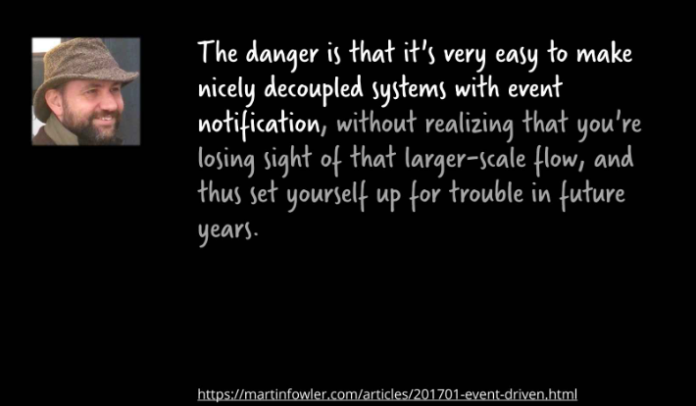
Event Driven Pitfall regarding workflows and pure choreography

Slide 27
Guided Choreography
Workflow definition exists
Workflow definition is instantiated as routing slip that is included in events
Available to each actor
Actors determine if the routing slip for an instance allows | prompts them to act
If so, they perform work then update routing slip and publish an event
And so on
Extremely flexible
Deploy and redeploy actors as desired
A/B and Canary testing
Modifying workflow definitions
Potentially even for running instances

Slide 28

Guided Choreography with Routing Slip
Payload
Instance Identifier
Workflow Definition Identifier
State (associated data)
Tasks
- Activity type
- Identifier
- Status (new | done | waiting | failed)
- Conditions/Dependencies
Audit
Workflow event
Workflow Initiator
Actor
Check if the routing slip contains a task that this actor can perform and that is released for execution
Check if the routing slip contains a task that this actor can perform and that is released for execution
Check if the routing slip contains a task that this actor can perform and that is released for execution
Check if the routing slip contains a task that this actor can perform and that is released for execution
Check if the routing slip contains a task that this actor can perform and that is released for execution
Workflow definitions
Check if the routing slip contains a task that this actor can perform and that is released for execution
Workflow [Event] Monitor
Event Bus
Actor
If it is, then perform the task and publish a new workflow event with updated state, task & audit
Actor
Workflow event
A Cloud- and Container-Based Approach to Microservices-Powered Workflows
28

Slide 29
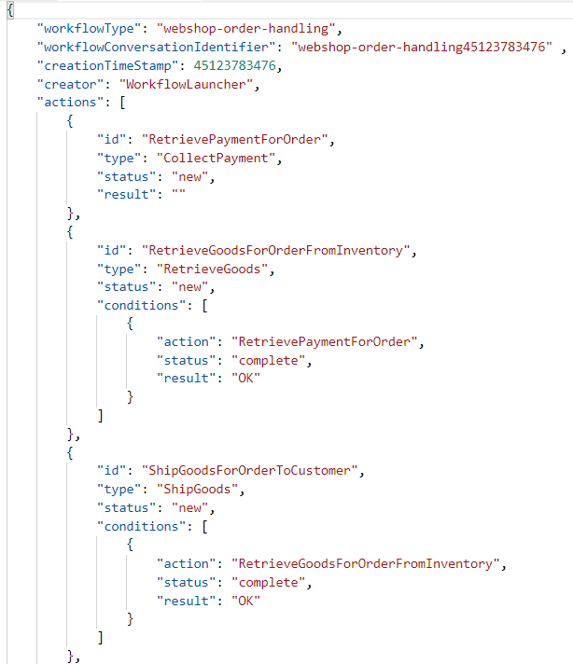
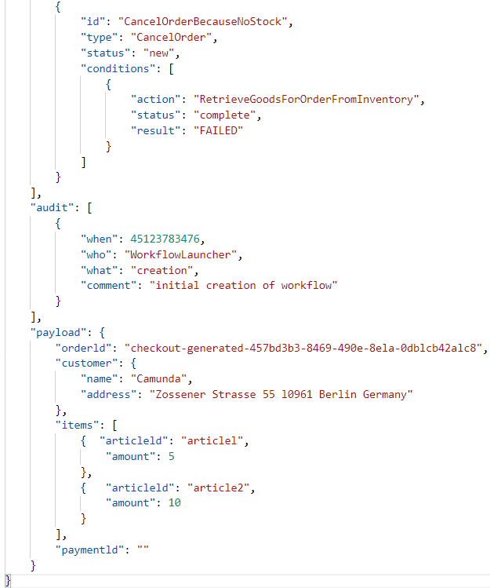
Routing Slip
checkout
Retrieve Payment
Retrieve Goods
Ship Goods
Cancel Order

Slide 30
Challenges with Guided Choreography – Routing Slip
Prevent multiple actors picking up the same task in an instance (concurrency)
Exclusively claim a task
Handle state updates by actors on parallel tasks (split brain state of routing slip)
Perhaps store state in distributed cache
Potentially inefficient as each actor evaluates all workflow events
For all workflows and all instances
Detect failing instances
Handle timers and signals
done

Slide 31
Best of Both Worlds: Hybrid – Coordinated Choreography
Asynchronous communication based on queues | commands | events
Distributed, stateless, horizontally scalable workflow engine
Data context (“state”)
State transition (workflow logic)
Communication (Event) handling
Publish tasks, receive task updates
Handle external and time triggers
Detect abandoned tasks, failing workflows
Publish metrics for monitoring workflow instances
Governance on [definitions of] Workflows and Events
Ensure that events are understood and an actor is available for each task [event]

Slide 32
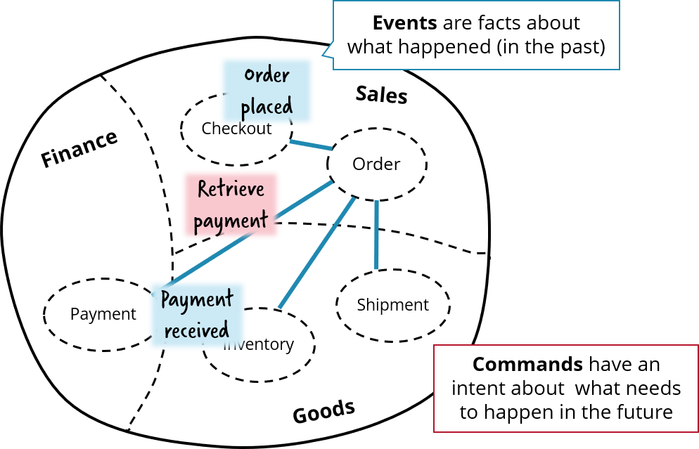
Commands are Events that express what should happen
Example: the Retrieve Payment event

Slide 33
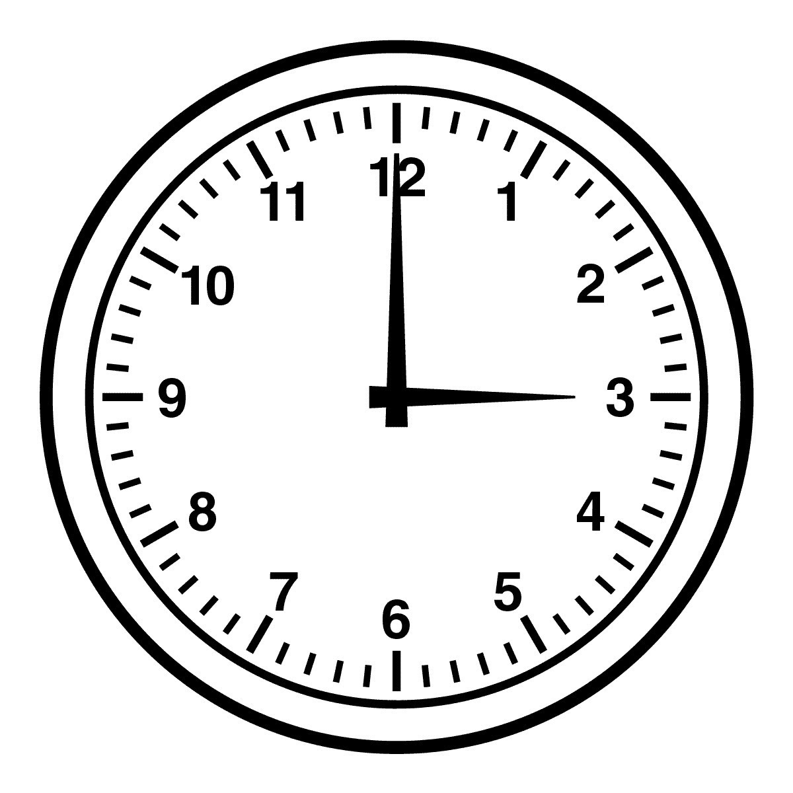
Decider – state engine
Workflow Definitions
Workflow Instance State
Take workflow definition
Take state & state change [events]
Take context (time)
Derive new state
Status of workflow instance
Status of activities
Inform task dispatcher
Update persisted state
Decider
Signals & Events
Task Queue/Dispatcher

Slide 34
Workflow definition management
Hold definitions of multiple workflows
And the associated data structures and event messages
Manage multiple versions of each workflow definition
and validity period for each version
Aid upgrade of running instances
Workflow Definitions

Slide 35
Task dispatcher & Actors
Publish tasks to be performed; with exactly once delivery
Publish task & data context
Allow actors to pick up [and claim] task
Detect unclaimed tasks and <do something>
Detect timed out tasks | failing actors
Interrupt running tasks
Detect regularly completed tasks
Task dispatcher & Actors publish metrics
Detect failed actor/reschedule task
Task Queue/Dispatcher
Interrupt running task (send signal)
Topic/ Queue
poll
Task Heart beat
heartbeat
Task update
Task Update
Actor
Actor
Actor
A Cloud- and Container-Based Approach to Microservices-Powered Workflows
35

Slide 36
Facilitated Choreography or: Orcheography
Hold data context for workflow instance
Workflow Instance State
Derive new state (status & actions to release) from workflow definition, current state, context (e.g. time)
Workflow Definitions
Deploy minor and major versions of workflow definitions
Decider
Publish tasks to be performed; with exactly once delivery
Detect failed actor/reschedule task
Signals & Events
Sweeper
Task Queue/Dispatcher
Interrupt running task (send signal)
Detect abandoned | stuck workflow instances
Topic/ Queue
poll
Task Heart beat
Handle external events and signals that could impact running instances (note: event from one workflow instance can be signal to other)
heartbeat
Task update
Produce time(out) events for workflow instances
Actor
Actor
Actor

Slide 37

Orcheography

Slide 38
Additionally in our workflow execution toolset
Human participants
Allocate
Notify
Provide multichannel Task UI
Task Management
Business indicators
Find WIP, Waste, Bottlenecks
Monitoring
Individual instances & Aggregates per Workflow
Technical/IT perspective & Business Activity
Rule Engine (for business logic inside the workflow)

Slide 39
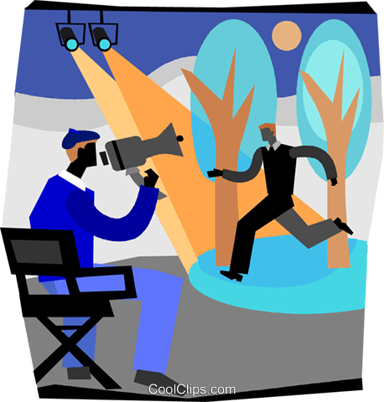
Involving Human Actors in Workflow
Who should perform this task?
Workflow
How to inform task-holder about new | expiring todo item?
allocate
Human Participant
notify
multi-channel
task specific user interface
Enable human to perform task (data, status)?
task management (todo list, claim | reject | delegate task)
Enable human to manage all her tasks

Slide 40
Microservice is actor as far as workflow engine should know – it decides if and how to involve a human
Directory
Notification Service
Workflow
µ
Generic Task Management application
Task Queue/Dispatcher
Task specific UI
Multi Channel Facilities (chatbot, portal, mobile)

Slide 41




Microservice is actor – proxy for the human contributor(s)
Directory
Notification Service
µ
Generic Task Management application
Task specific UI
Multi Channel Facilities (chatbot, portal, mobile)

Slide 42
Facilities for Workflow Management
Deploy minor and major versions of workflow definitions
Hold data context for workflow instance
Workflow Instance State
Derive new state (status & actions to release) from workflow definition, current state, context (e.g. time)
Monitoring & Reporting
Workflow Definitions
Workflow & Task Metrics
Decider
Publish tasks to be performed; with exactly once delivery
Detect failed actor/reschedule task
Signals & Events
Sweeper
Task Queue/Dispatcher
Allocation, Notification, Task Mgt
Interrupt running task (send signal)
Detect abandoned | stuck workflow instances
Topic/ Queue
poll
Task Heart beat
Handle external events and signals that could impact running instances
heartbeat
Task update
Rule Evaluation
Produce time(out) events for workflow instances
Actor
Actor
Actor

Slide 43
Orchestration with proxy actors for decoupled (microservice) actors
Multi-instance, Distributed,Scalable
Flexible workflow definition
Shared, flexible instance state
Workflow Instance State
Orchestration engine
Proxy Actor
Proxy Actor
Proxy Actor
Proxy Actor
API Gateway
Enterprise Service Bus
SOAP
µ
µ
µ
µ
µ
λ
SOAP
SOAP

Slide 44
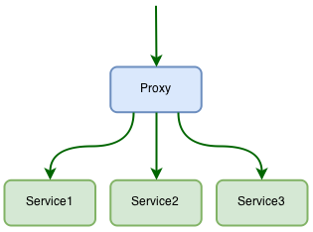
Hybrid (2)
Embrace (or at least allow) synchronous orchestration within a domain or bounded context
For (parts of) flows that are the responsbility within a domain – and a team
And use (facilitated) choreography for flows stretching across domains
To retain strong decoupling and flexibility between domains
Perhaps a Proxy service can consume the “choreographed” event and turn it in locally orchestrated logic
Notes:
https://stackoverflow.com/questions/29117570/orchestrating-microservices

Slide 45
Cross Bounded Context | Domain
Workflow Definitions
Facilitated Choreography
Workflow & Task Metrics
Task Queue/Dispatcher
Workflow Instance State
Proxy
Actor
Facilitated Choreography
Orchestrator
Orchestrator
µ
λ
µ
µ
µ
µ
λ

Slide 46
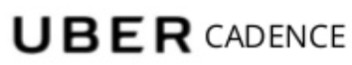



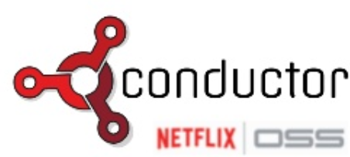
Cross Domain
Workflow Definitions
Facilitated Choreography
Workflow & Task Metrics
Task Queue/Dispatcher
Workflow Instance State
Proxy
Actor
Facilitated Choreography
Orchestrator
Orchestrator
µ
λ
µ
µ
µ
µ
λ

Slide 47
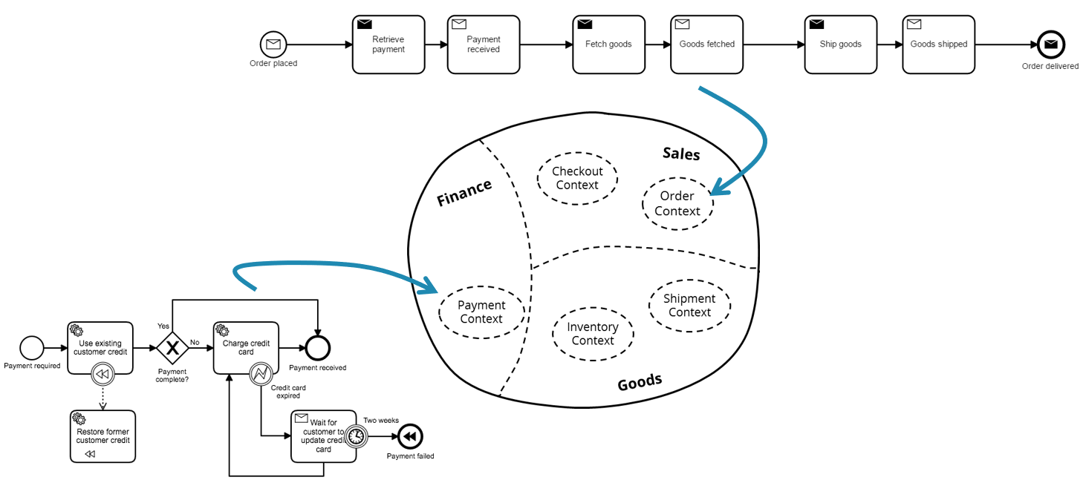
Demo Hybrid Orchestration (Orcheography) – Flowing Retail
Place Order

Slide 48
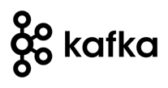
Demo Orcheographed Workflow
Orchestrator
OrderPlacedEvent
Order Context
Proxy
Actor
Proxy
Actor
Checkout Context
Proxy
Actor
Retrieve Payment
Fetch Goods
Ship Goods
Event Bus
Retrieve Payment
Ship Goods
Fetch Goods
GoodsShipped Event
µ
PaymentReceived Event
µ
µ
GoodsFetched Event
µ
µ
µ
Payment Context
Shipment Context
Inventory Context
Orchestrator
Notes:
https://github.com/berndruecker/flowing-retail/blob/master/kafka/java/order-camunda/src/main/resources/order.bpmn

Slide 49
Demo Orcheographed Workflow
Orchestrator
OrderPlacedEvent
Order Context
Proxy
Actor
Proxy
Actor
Checkout Context
Proxy
Actor
Retrieve Payment
Fetch Goods
Ship Goods
Event Bus
Retrieve Payment
Ship Goods
Fetch Goods
GoodsShipped Event
µ
PaymentReceived Event
µ
µ
GoodsFetched Event
µ
µ
µ
Payment Context
Shipment Context
Inventory Context
Orchestrator
Notes:
https://github.com/berndruecker/flowing-retail/blob/master/kafka/java/order-camunda/src/main/resources/order.bpmn

Slide 50
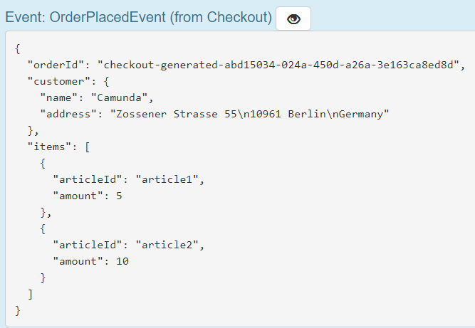
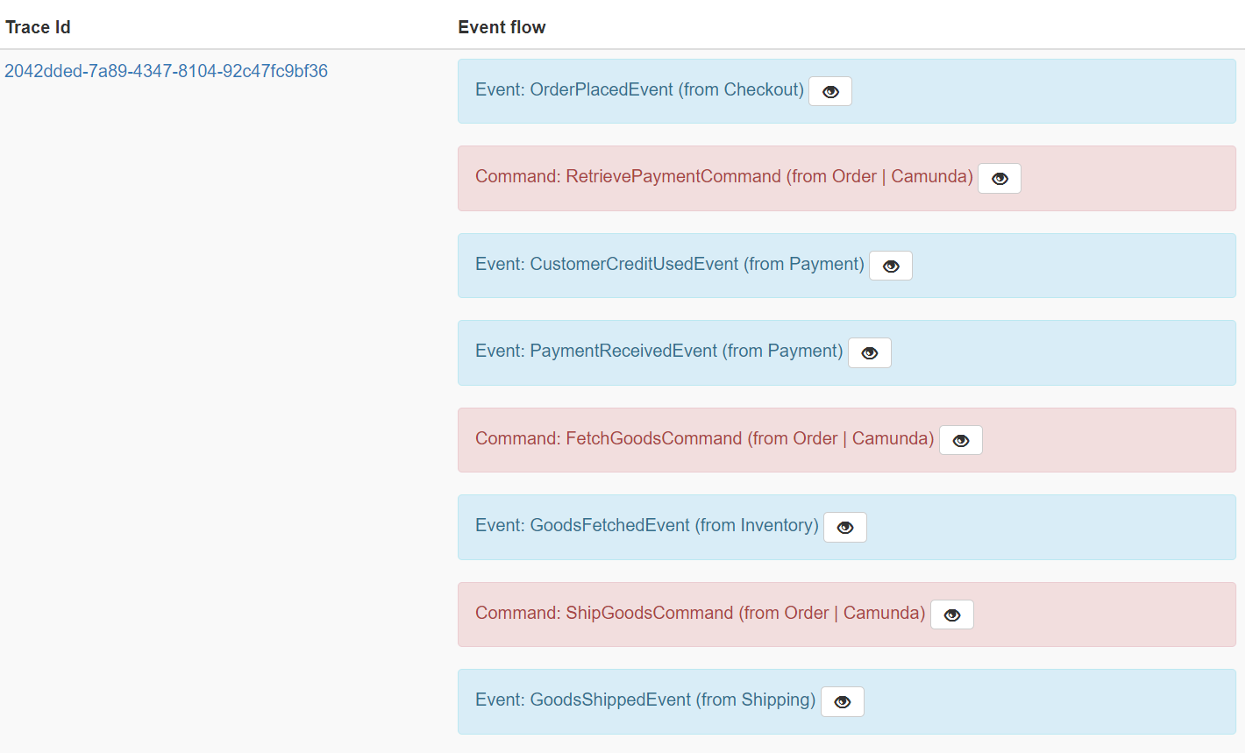
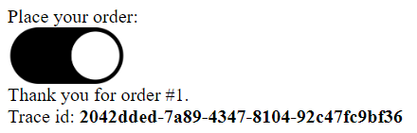

Demo Orcheographed Workflow
Event Bus

Slide 51
Summary
Workflows exist – also in microservice environments
Short running composite transactions ⬄ Long running business process
Responsibility for running workflow instances can be a cross cutting concern – outside the scope of any individual microservice
All generic workflow components need to be agile, scalable, distributed, cloud-enabled
For resilience, scale, flexible evolution, optimal use of resources
A lot can happen over the lifetime of a workflow instance – that need to be catered for
Events, changes in data context, modification of workflow definition Scenarios
Workflows within single bounded context could be pure orchestration
Workflows across bounded contexts should use decoupled, choreographed workflow coordination [between bounded contexts]
That can span across technologies, physical locations, vendors and clouds

Slide 52



Summary
Several frameworks, services and tools are available for supporting workflow management (e.g. AWS SWF, Zeebe, Camunda, Baker, Cadence, Conductor, Project Fn Flow , Azure Logic Apps)
Born from real life needs
Microservice oriented and [hybrid] cloud enabled
At heart pre-configured combinations of queue, event bus, NoSQL data store, rule engine, …
Roll your own can be fun – and also quite challenging

Slide 53
Source: https://www.infoq.com/articles/events-workflow-automation
Notes:
https://www.infoq.com/articles/events-workflow-automation

Slide 54





Thank you Dank je wel
Blog: technology.amis.nl
Email: lucas.jellema@amis.nl
: @lucasjellema
: lucas-jellema
: www.amis.nl, info@amis.nl

Slide 55
Challenges
Exactly once delivery of task to actor
Lock? Queue? Direct call?
Detect failed | abandoned task execution (& reschedule)
Heartbeat? Timeout?
Compensation (for failed transaction)
Timer events
Handle Signals/Events to impact running instance
Correlation (tags/indexes) to locate impacted instances
Communicate with/interrupt actors
Monitor individual instances and across instances
Deal with peak load and high priority instances and tasks
Distributed, scaled & Ephemeral actors and workflow engine
How to design workflow in a way that users understand, IT-staff can create and workflow engines can process

